Slide 1
SWE 4803
Lec - 2

Slide 2
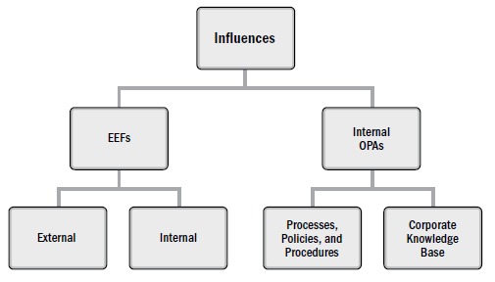
The Environment in which Projects Operate
Environment may have influence on each project
Two major categories of influences are
  enterprise environmental factors (EEFs): originate from the environment outside of the project and often outside of the enterprise. may have an impact at the organizational, portfolio, program, or project level.
  organizational process assets (OPAs): internal to the organization. These may arise from the organization itself, a portfolio, a program, another project, or a combination of these.

Slide 3
Enterprise Environmental Factors
The following EEFs are internal to the organization:
Organizational culture, structure, and governance: Examples include vision, mission, values, beliefs, cultural norms, leadership style, hierarchy and authority relationships, organizational style, ethics, and code of conduct.
Geographic distribution of facilities and resources: Examples include factory locations, virtual teams, shared systems, and cloud computing.
Infrastructure: Examples include existing facilities, equipment, organizational telecommunications channels, information technology hardware, availability, and capacity.
Information technology software: Examples include scheduling software tools, configuration management systems, web interfaces to other online automated systems, and work authorization systems.
Resource availability: Examples include contracting and purchasing constraints, approved providers and subcontractors, and collaboration agreements.
Employee capability: Examples include existing human resources expertise, skills, competencies, and specialized knowledge.

Slide 4
Enterprise Environmental Factors
The following EEFs are external to the organization:
Marketplace conditions: Examples include competitors, market share brand recognition, and trademarks.
Social and cultural influences and issues: Examples include political climate, codes of conduct, ethics, and perceptions.
Legal restrictions: Examples include country or local laws and regulations related to security, data protection, business conduct, employment, and procurement.
Commercial databases: Examples include benchmarking results, standardized cost estimating data, industry risk study information, and risk databases.
Government or industry standards: Examples include regulatory agency regulations and standards related to products, production, environment, quality, and workmanship.
Financial considerations: Examples include currency exchange rates, interest rates, inflation rates, tariffs, and geographic location.

Slide 5
Organizational Process Assets
OPAs include any artifact, practice, or knowledge from any or all the performing organizations involved in the project that can be used to execute or govern the project.
They may be grouped into two categories:
  Processes, policies, and procedures
  Organizational knowledge bases

Slide 6
Organizational Structure
Factors to consider in selecting an organizational structure include but are not limited to:
  Degree of alignment with organizational objectives
  Clear path for escalation of decisions
  Clear line and scope of authority
  Delegation capabilities
  Accountability assignment
  Responsibility assignment
  Efficiency of performance
  Physical locations (e.g., co-located, regional, and virtual), and
  Clear communication (e.g., policies, status of work, and organization’s vision).

Slide 7
Organizational Structure
Organizational structures take many forms or types
  Organic or Simple
  Functional (centralized)
  Multi-divisional (may replicate functions for each division with little centralization)
  Matrix – strong
  Matrix – weak
  Matrix – balanced
  Project-oriented (composite, hybrid)
  Hybrid
  PMO

Slide 8
Organizational Structure
Organic or Simple
  Work Groups Arranged by: people working side-by-side
  Project Manager’s Authority : Little or none
  Project Manager’s Role : Part-time; may or may not be a designated job role like coordinator
  Resource Availability : Little or none
  Who Manages the Project Budget? : Owner
  Project Management Administrative Staff : Little or none

Slide 9
Organizational Structure
Functional (centralized)
  Work Groups Arranged by: Job being done (e.g., engineering, manufacturing)
  Project Manager’s Authority : Little or none
  Project Manager’s Role : Part-time; may or may not be a designated job role like coordinator
  Resource Availability : Little or none
  Who Manages the Project Budget? : Functional manager
  Project Management Administrative Staff : Part-time

Slide 10
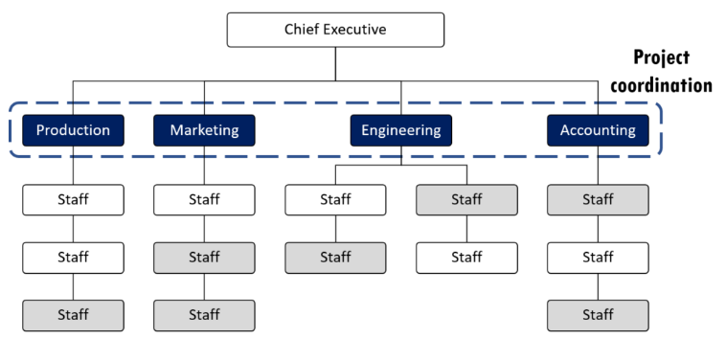
Organizational Structure
Functional

Slide 11
Organizational Structure
Multi-divisional (may replicate functions for each division with little centralization)
  Work Groups Arranged by: One of product, production processes, portfolio, program, geographic region, customer type
  Project Manager’s Authority : Little or none
  Project Manager’s Role : Part-time; may or may not be a designated job role like coordinator
  Resource Availability : Little or none
  Who Manages the Project Budget? : Functional manager
  Project Management Administrative Staff : Part-time

Slide 12
Organizational Structure
Matrix – strong
  Work Groups Arranged by: By job function, with project manager as a function
  Project Manager’s Authority : Moderate or High
  Project Manager’s Role : Full-time designated job role
  Resource Availability : Moderate or High
  Who Manages the Project Budget? : Project manager
  Project Management Administrative Staff : Full-time

Slide 13
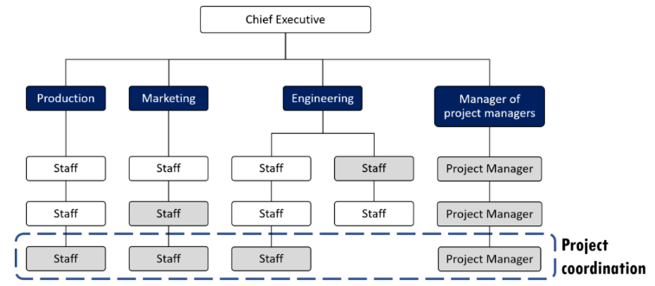
Organizational Structure
Matrix – strong

Slide 14
Organizational Structure
Matrix – Weak
  Work Groups Arranged by: By job function
  Project Manager’s Authority : Low
  Project Manager’s Role : Part-time; done as part of another job and not a designated job role like coordinator
  Resource Availability : Low
  Who Manages the Project Budget? : Functional manager
  Project Management Administrative Staff : Part-time

Slide 15
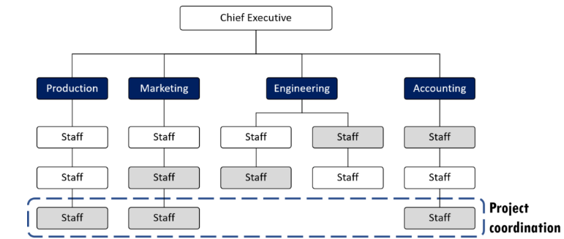
Organizational Structure
Matrix – weak

Slide 16
Organizational Structure
Matrix – Balanced
  Work Groups Arranged by: By job function
  Project Manager’s Authority : Low or Moderate
  Project Manager’s Role : Part-time; done as part of another job and not a designated job role like coordinator
  Resource Availability : Low or Moderate
  Who Manages the Project Budget? : Mixed
  Project Management Administrative Staff : part-time

Slide 17
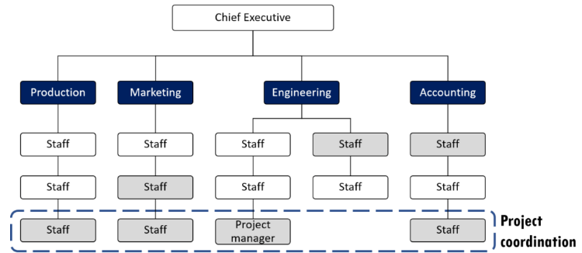
Organizational Structure
Matrix – balanced

Slide 18
Organizational Structure
Project-oriented (composite, hybrid)
  Work Groups Arranged by: Project
  Project Manager’s Authority : High to almost total
  Project Manager’s Role : Full-time designated job role
  Resource Availability : High to almost total
  Who Manages the Project Budget? : Project manager
  Project Management Administrative Staff : Full-time

Slide 19
Organizational Structure
Hybrid
  Work Groups Arranged by: Mix of other types
  Project Manager’s Authority : Mixed
  Project Manager’s Role : Mixed
  Resource Availability : Mixed
  Who Manages the Project Budget? : Mixed
  Project Management Administrative Staff : Mixed

Slide 20
Organizational Structure
PMO (Project Management office)
  Work Groups Arranged by: Mix of other types
  Project Manager’s Authority : High to almost total
  Project Manager’s Role : Full-time designated job role
  Resource Availability : High to almost total
  Who Manages the Project Budget? : Project Manager
  Project Management Administrative Staff : Full - Time

Slide 21
Project Management Office
    PMO is an organizational structure that standardizes the project-related governance processes and facilitates the sharing of resources, methodologies, tools, and techniques.
    responsibilities of a PMO can range from providing project management support functions to the direct management of one or more projects.
    primary function of a PMO:
      Managing shared resources across all projects administered by the PMO;
      Identifying and developing project management methodology, best practices, and standards, Coaching, mentoring, training, and oversight
      Monitoring compliance with project management standards, policies, procedures, and templates by means of project audits
      Developing and managing project policies, procedures, templates, and other shared documentation (organizational process assets)
      Coordinating communication across projects

Slide 22
Project Management Office
    types of PMOs in organizations:
Supportive
provide a consultative role to projects by supplying templates, best practices, training, access to information, and lessons learned from other projects.
This type of PMO serves as a project repository.
The degree of control provided by the PMO is low.
PMO
Controlling
provides support and requires compliance through various means.
The degree of control provided by the PMO is moderate
Compliance may involve:
  Adoption of project management frameworks or methodologies,
  Use of specific templates, forms, and tools…
Directive
take control of the projects by directly managing the projects.
Project managers are assigned by and report to the PMO.
The degree of control provided by the PMO is high.

Slide 23

Think Yourself..
You are the Project Managers of XYZ consultants. The Project team members are from Finance and HR departments. The team members report to Finance and HR Managers respectively, and you have limited control over them. What type of organizational structure does XYZ consultants follow?
A project manager is trying to complete a SW development project, but can not get enough attention for the project. Resources are focused on completing process-related work and the PM has little authority to properly assign resources. What form of organization must the PM be working in?

Slide 24

Role of a Project Manager (PM)
Conductor who directs the performance with movements of the hands and arms, often made easier for the musicians

Slide 25
Role of a Project Manager (PM)
Membership and roles:
A large project and an orchestra each comprise many members, each playing a different role.
A large orchestra may have more than 100 musicians who are led by a conductor.
These musicians may play 25 different kinds of instruments
Similarly, a large project may have more than 100+ project members led by a project manager.
Team members may fulfill many different roles, such as design, manufacturing, and facilities management.

Slide 26
Role of a Project Manager (PM)
Responsibility for team:
The project manager and conductor are both responsible for what their teams produce
The two leaders need to take a holistic view of their team’s products in order to plan, coordinate, and complete them.
The two leaders establish their interpretation of the vision, mission, and objectives involved in successfully completing their products.
The leaders use their interpretation to communicate and motivate their teams toward the successful completion of their objectives.

Slide 27
Role of a Project Manager (PM)
Knowledge and skills:
The conductor is not expected to be able to play every instrument in the orchestra, but should possess musical knowledge, understanding, and experience.
The conductor provides the orchestra with leadership, planning, and coordination through communications.
The conductor provides written communication in the form of musical scores and practice schedules.
The conductor also communicates in real time with the team by using a baton and other body movements.
The project manager is not expected to perform every role on the project, but should possess project management knowledge, technical knowledge, understanding, and experience.
The project manager provides the project team with leadership, planning, and coordination through communications.
The project manager provides written communications (e.g., documented plans and schedules) and communicates in real time with the team using meetings and verbal or nonverbal cues.

Slide 28
Role of a Project Manager (PM)
Make sure the project is completed within Schedule and within budget
Determine and deliver required level of quality
Select Appropriate process for the project
Identifies and analyses constrains and assumptions
Leads and directs project planning effort
Identifies dependencies between activities
Assist project team during execution
Reports Project progress on time
Project Manager is accountable for project success or failure

Slide 29
Project Manager (PM)
The project manager is the person assigned by the performing organization to lead the team that is responsible for achieving the project objectives.
How the project manager differ from functional or operational manager?
The functional manager focuses on providing management oversight for a functional or business unit. Operations managers are responsible for ensuring that business operations are efficient.

Slide 30
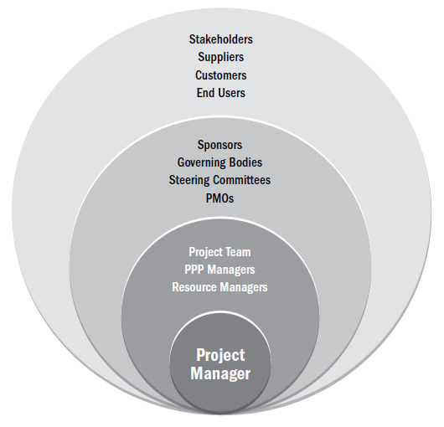
Project Manager’s Sphere of Influence

Slide 31
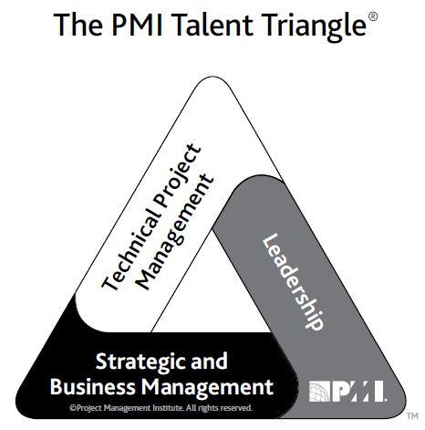
Project Manager Competency
Technical project management. The knowledge, skills, and behaviors related to specific domains of project, program, and portfolio management. The technical aspects of performing one’s role.
Leadership. The knowledge, skills, and behaviors needed to guide, motivate, and direct a team, to help an organization achieve its business goals.
Strategic and business management. The knowledge of and expertise in the industry and organization that
enhanced performance and better delivers business outcomes.

Slide 32
Leadership
Project managers may lead their teams in many ways.
The leadership style a project manager selects may be a personal preference, or the result of the combination of multiple factors associated with the project.
  Leader characteristics (e.g., attitudes, moods, needs, values, ethics);
  Team member characteristics (e.g., attitudes, moods, needs, values, ethics);
  Organizational characteristics (e.g., its purpose, structure, and type of work performed); and
  Environmental characteristics (e.g., social situation, economic state, and political elements).

Slide 33
Leadership Styles
Laissez-faire (e.g., allowing the team to make their own decisions and establish their own goals, also referred to as taking a hands-off style);
Transactional (e.g., focus on goals, feedback, and accomplishment to determine rewards; management by exception);
Servant leader (e.g., demonstrates a commitment to serve and put other people first; focuses on other people’s growth, learning, development, autonomy, and well-being; concentrates on relationships, community and collaboration; leadership is secondary and emerges after service);
Transformational (e.g., empowering followers through idealized attributes and behaviors, inspirational motivation, encouragement for innovation and creativity, and individual consideration);
Charismatic (e.g., able to inspire; is high-energy, enthusiastic, self-confident; holds strong convictions);

Slide 34
Leadership Styles
Transformational
Charismatic
Jeff Bezos is the most famous example of a transformational leader. Like many companies, Amazon operates under the instruction that the customer is king, so Bezos and his team dedicated their first year of business to generating customer reviews, a practice that was unheard of in e-commerce at the time.
Steve Jobs is a great example. When he returned to Apple in 1997 as the chief executive officer, the company was nearly bankrupt, but he made several big changes fast. He:
Convinced Microsoft to invest $150m
Cut the number of Apple products by 70%
Cut around 3,000 jobs
This led to an unbelievable $309m profit the following year.

Slide 35
Personality
    Personality refers to the individual differences in characteristic patterns of thinking, feeling, and behaving.
Personality characteristics or traits include but are not limited to:
Authentic (e.g., accepts others for what and who they are, show open concern);
Courteous (e.g., ability to apply appropriate behavior and etiquette);
Creative (e.g., ability to think abstractly, to see things differently, to innovate);
Cultural (e.g., measure of sensitivity to other cultures including values, norms, and beliefs);
Emotional (e.g., ability to perceive emotions and the information they present and to manage them; measure of interpersonal skills);
Intellectual (e.g., measure of human intelligence over multiple aptitudes);
Managerial (e.g., measure of management practice and potential);
Political (e.g., measure of political intelligence and making things happen);
Service-oriented (e.g., evidence of willingness to serve other people);
Social (e.g., ability to understand and manage people); and
Systemic (e.g., drive to understand and build systems).

Slide 36
“leadership” and “personality” are synonymous, do you agree?

Slide 37
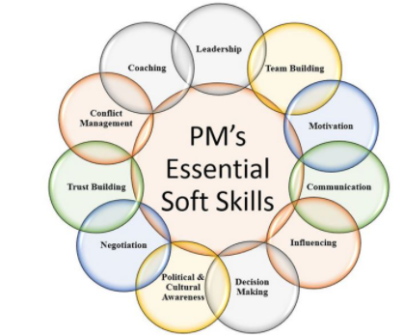
PM’s Soft skills

